Slide 1

A REAL TIME CHAT AND COMMUNICATION APP SUBMITTED BY: TEAM MEMBERS 1.SIVARANJANI . J (LEADER) 2.VISALEY .K 3.RANJANI . V 4.MONIKA . R

Slide 2
Enhancing Collaboration and Insight: A Real-Time Charting and Communication Application

Slide 3




INTRODUCTION
Enhancing Collaboration and Insight through a Real-Time Charting and Communication Application is essential in today's fast-paced environment. This presentation will explore how such tools can foster teamwork, streamline processes, and improve decision- making across various sectors.

Slide 4





IMPORTANCE OF COLLABORATION
In the digital age, collaboration is crucial. It leads to increased productivity and innovation. By leveraging real-time tools, teams can share insights instantly, making it easier to adapt to changing circumstances and enhancing overall eﬃciency.

Slide 5




REAL-TIME CHARTING BENEFITS
Real-time charting provides immediate access to data visualization, enabling teams to grasp complex information quickly. This allows for faster analysis and more informed decision- making, essential for maintaining a competitive edge in any industry.

Slide 6


EFFECTIVE COMMUNICATION TOOLS
Utilizing communication tools within a real- time application ensures that all team members are aligned. Features like instant messaging, video conferencing, and shared documents facilitate seamless interaction, reducing the chances of misunderstandings.

Slide 7

INTEGRATION WITH EXISTING SYSTEMS
A successful real-time application should seamlessly integrate with existing systems. This ensures that teams can leverage current tools and data, enhancing workﬂow eﬃciency without the need for extensive retraining or system overhauls.

Slide 8

CASE STUDIES
Several organizations have successfully implemented real-time charting and communication applications. These case studies demonstrate signiﬁcant improvements in team collaboration, project outcomes, and overall organizational performance, showcasing best practices.

Slide 9

CHALLENGES AND SOLUTIONS
While implementing these applications can pose challenges such as technical issues or user resistance, addressing these proactively with adequate training and support can lead to successful adoption and long-term beneﬁts for the organization.

Slide 10
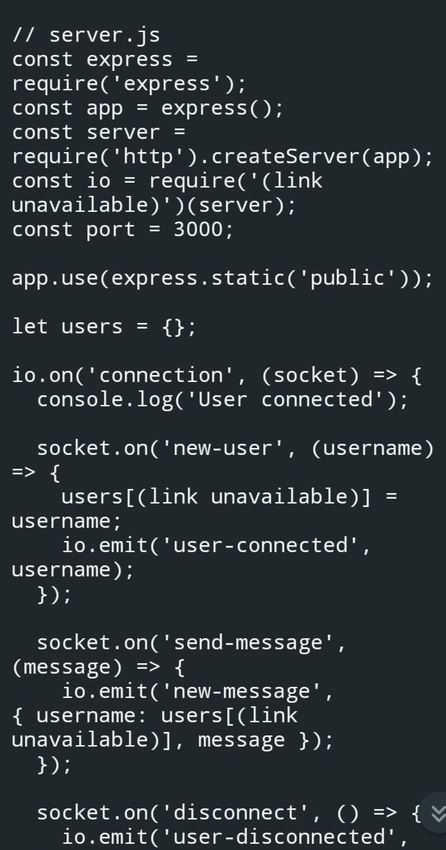
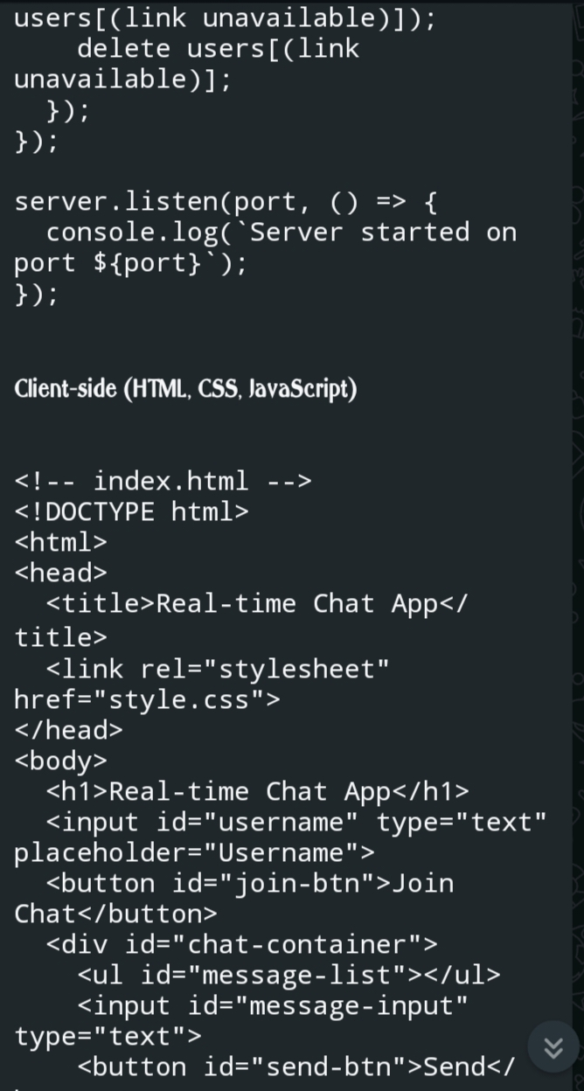
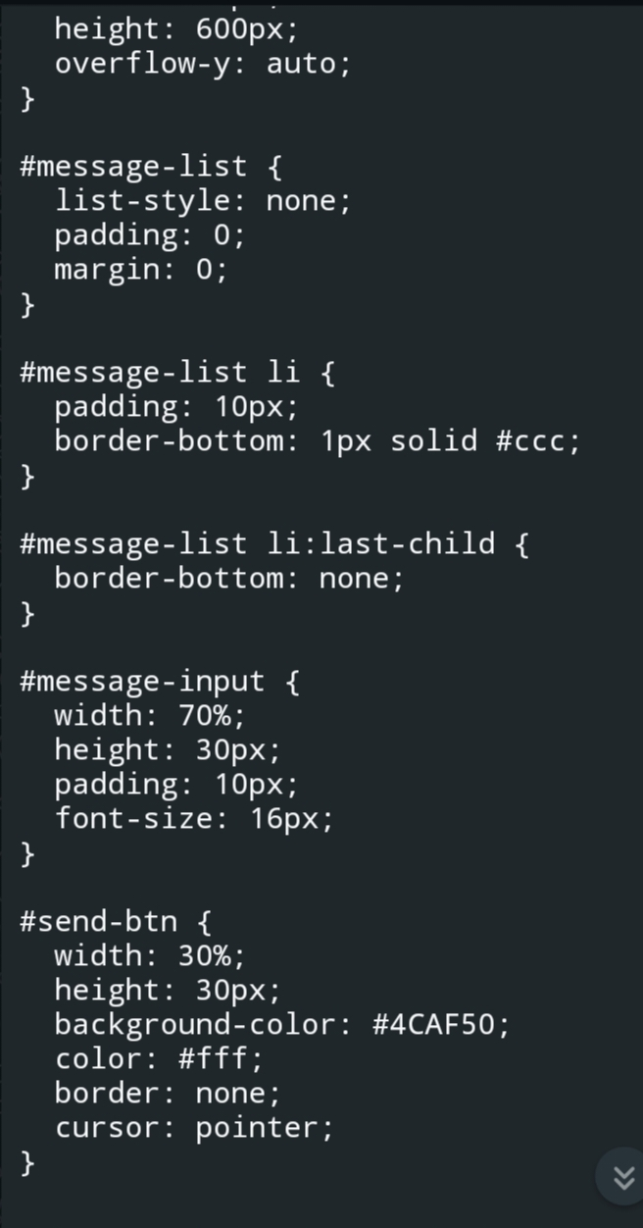

Slide 11
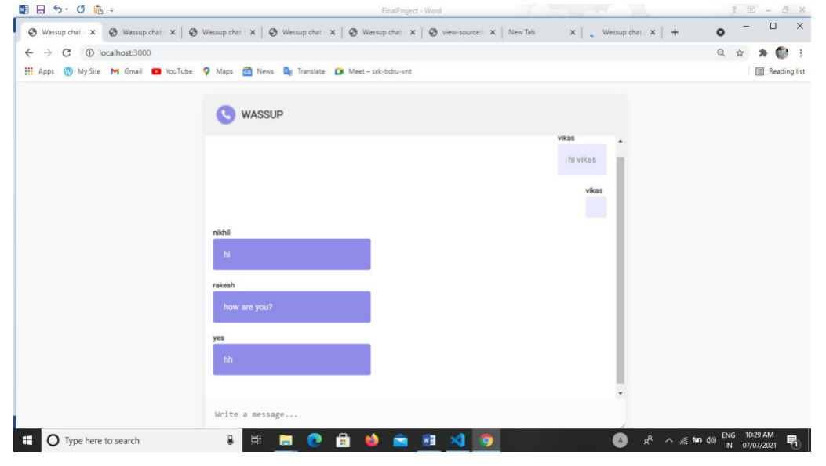

Slide 12
CONCLUSION
In conclusion, enhancing collaboration and insight through a real-time charting and communication application is not just beneﬁcial but essential. By embracing these tools, organizations can foster a more innovative, agile, and productive environment.

Slide 13


